Slide 1
Zonta Advances You!
Science Club Project
2018-2020
In honor of the 100th Anniversary of ZI
Organized by ZI District 20

Slide 2
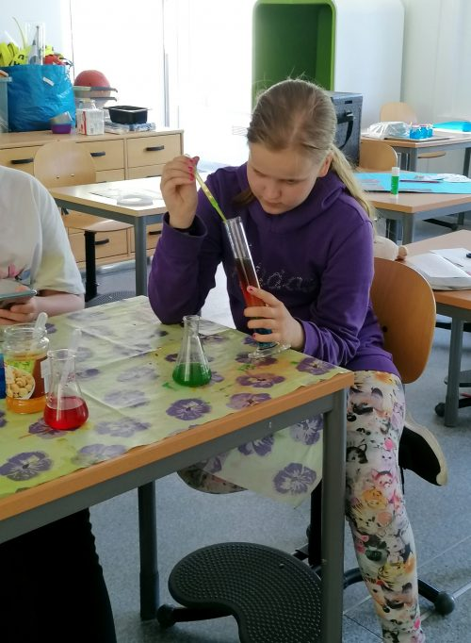
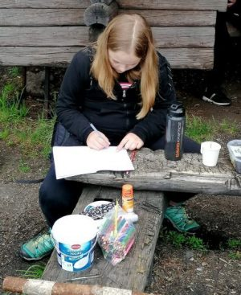
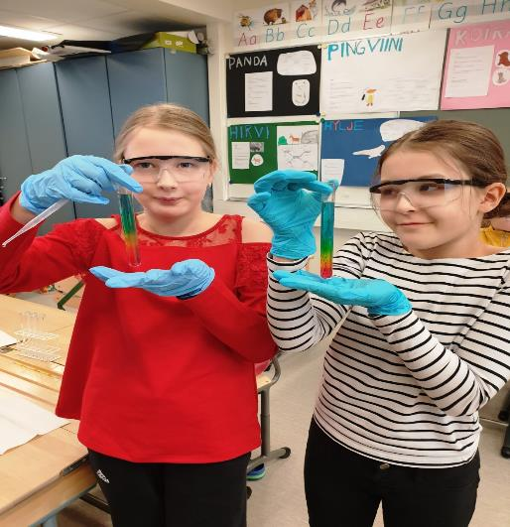
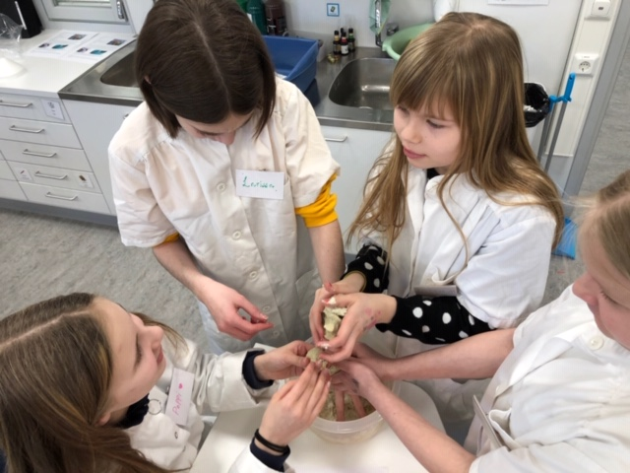

Slide 3
Goals of the project
To promote the basic idea of Zonta organization: improving the status of girls and women while also promoting gender equality!
To highlight the need to challenge men and women alike, fathers and mothers, to support girls and encourage them to believe in their own abilities.
To encourage the girls from the early stages of education to later levels to include mathematics and other science- and technology-related subjects in their curricula.
to increase girls’ interest towards the fields of mathematics, science and technology through novel innovations in science and technology education. The project was implemented during 2018-2021 in collaboration with the national LUMA Centre Finland network (11 universities, 13 Centres) by organizing ZAU seminars and clubs in various parts of Finland, as well as online. Most novel research information on the topic was utilized in the planning and implementation of the program.

Slide 4
Zonta partner:
LUMA Centre Finland
LUMA Centre Finland promotes competence in LUMA subjects which are mathematics, science and technology.
The mission of LUMA Centre Finland -network is to ensure a sufficient number of science and technology professionals all across Finland by enhanced science education.
To achieve this, LUMA Centre Finland inspires and motivates children and youth into mathematics, science and technology through the latest methods and activities.
See for further info: https://www.luma.fi/en/

Slide 5
Implementation
Fundraising result was 149,750 € (Euros)
LUMA Centre Finland implemented 55 normal and 3 virtual ZAU Clubs
Through the novel ZAU Clubs, science and technology were introduced to around 2000 participants – children and families – collaboratively through inquiry.
The club activities related to versatile themes, such as everyday life phenomena, mathematics, robots, and programming.
And all this despite of Covid -19 pandemic!

Slide 6
Campaign fundraising
During the campaign period (April 2018 – November 2019) Zonta Clubs in Finland and Estonia carried out fundraising in following ways:
Organizing special events and seminars to promote the ZAU Campaign, discussing for instance, gender equality and how each woman and girl can make a difference
Selling special ZAU products (ZAU Reflectors , Woollen Mittens with reflecting decorations and yellow rose necklaces)
Selling clubs’ own products, at their events for the campaign
Inviting donations by circulating special Collection Boxes or making a donation on the Website.
Donating is the most important form of fundraising. Many people are willing to support a good cause, but they do not want to receive any goods in return!
Detailed information was sent to the Zonta Clubs and Zontians with special appeal to our partners and sponsors.

Slide 7
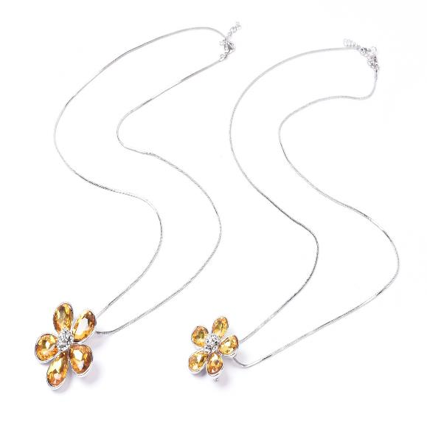
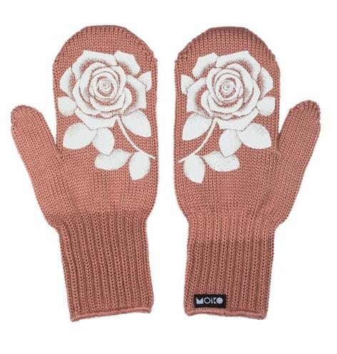
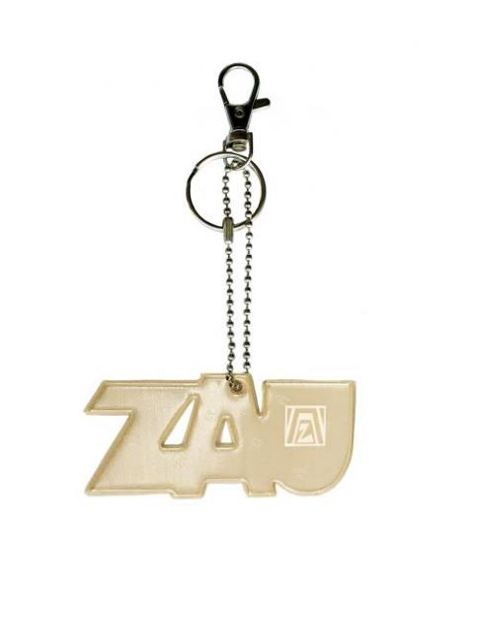
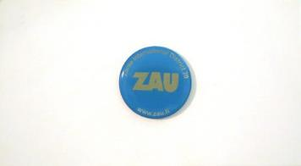
Products

Slide 8
